Slide 1
STM32 OLED Driver: Design, Code, and Usage
Nabil KANA

Slide 2
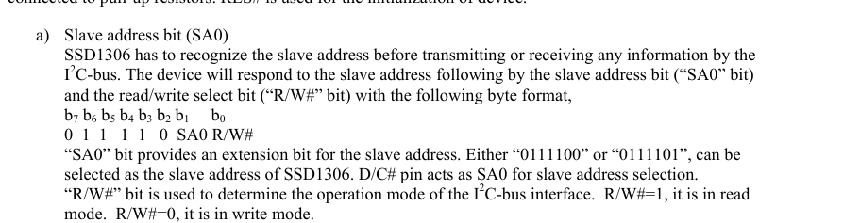
Overview :
I made a driver to control an OLED screen using an STM32 and I2C. It can show text and emojis on a 128x64 display. The code handles the communication and drawing fonts.
Essential control functions :
- ssd1306 Datasheet page 19 -

Slide 3
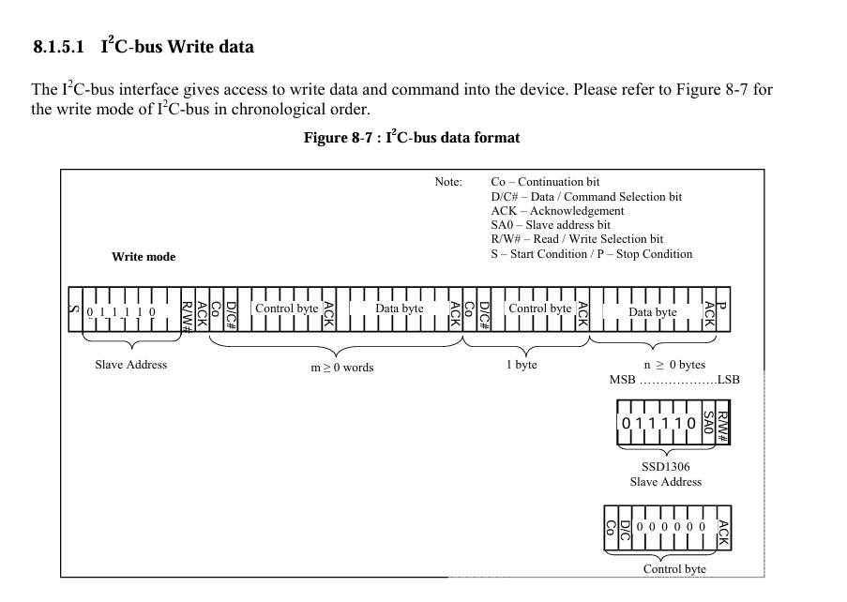
- ssd1306 Datasheet page 20 -

Slide 4
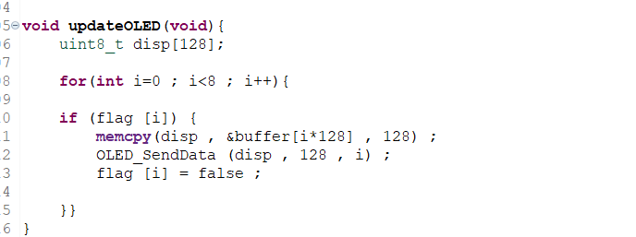
In order to write to the OLED , we first need its address which is specified above and since we want to write to the device R/W should be set to 0 which results in the address being 0x78 defined in the header file , in order to send command like controlling contrast or changing addressing type the Co and D/C bits should be set to 0 whereas if we want to send data D/C should be set to 1 , thus for sendCommand function the first byte should be 0x00 so the oled expects a control byte , where for sendData the first byte should be 0x40 , a couple of commands need to be sent each initialization like setting contrast , addressing mode and turning on the display (lookup COMMAND Table -Datasheet) , since we are aiming to only updated overwritten rows each update to reduce i2c traffic , the sendData function will send w row at a time (start and end address is set to variable row ) , the data and row number will be sent from update function that checks which page was overwritten with a flag array

Slide 5
The user can set the cursor by sending x and y coordinates through the SetCursor function , the resulting position of the cursor will also depend on the Font used as the user can choose one of three different font sizes and an emoji one . this Font can be selected by SetFont(& Font_8x8) ; or any convenient size (lookup main.c for a practical example). The fonts are stored in separate files that will be called by OLED_Driver.h , each font is a struct that calls its own writing function , that will overwrite the buffer based on a global pointer static const Fonts* CurrentFont;pointing to the Font struct being used . In order to look up the Bytes corresponding to a given character from the bitmaps , a lookup table was defined alongside a GetIndex function that looks up the corresponding index . Notes : Ensure I2C2 is enabled in CubeMX configuration.
Set PB10 as I2C2_SCL and PB11 as I2C2_SDA.
Configure the I2C Clock Speed (typically 100kHz or 400kHz for SSD1306).
Generate code to make sure hi2c2 is initialized properly.
Use PULLUP resistors for SDL and SDA wires
To expand functionality, you can:
Create new bitmap fonts or emoji sets.
Add .c/.h font files similar to Font_8x8 or Font_emojis.
Use SetFont() and OLEDWrite() functions to display them.

Slide 6
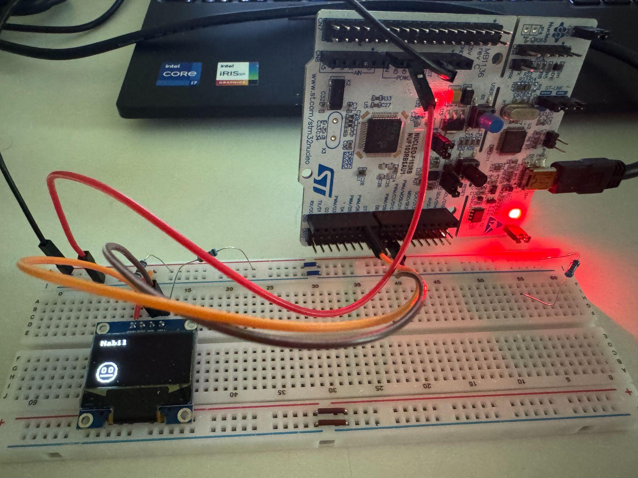
custom string and emoji font using Font_8x8 and Font_emojis.

